Slide 1
Data analysis and field study on Toronto restaurant
By Henrique Pan

Slide 2
Benefits of this study
By analysing the neighbourhoods one can identify
The number of restaurants in the vicinity
The number of restaurants offering similar cuisines in the vicinity
The distance from the city centre.
It gives an brief overview of the neighbourhood and competition for the business
This becomes a good starting point for the individual to start his search for a good location

Slide 3
Data Acquisition and Cleaning
Get the details of the city center and neighbouring boroughs
Identifying the restaurants in these areas
Finding out the categories of restaurants
Identifying the areas with less restaurant density

Slide 4
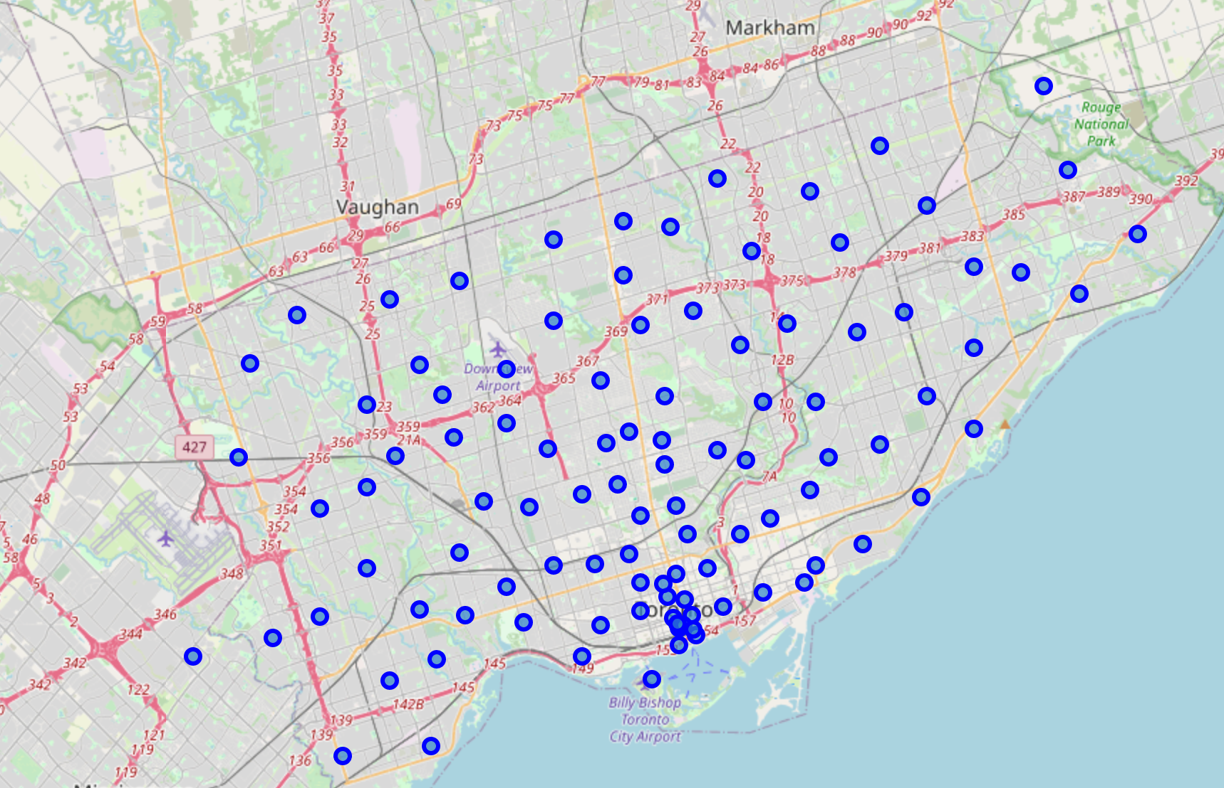
Identify City center and surroundings

Slide 5
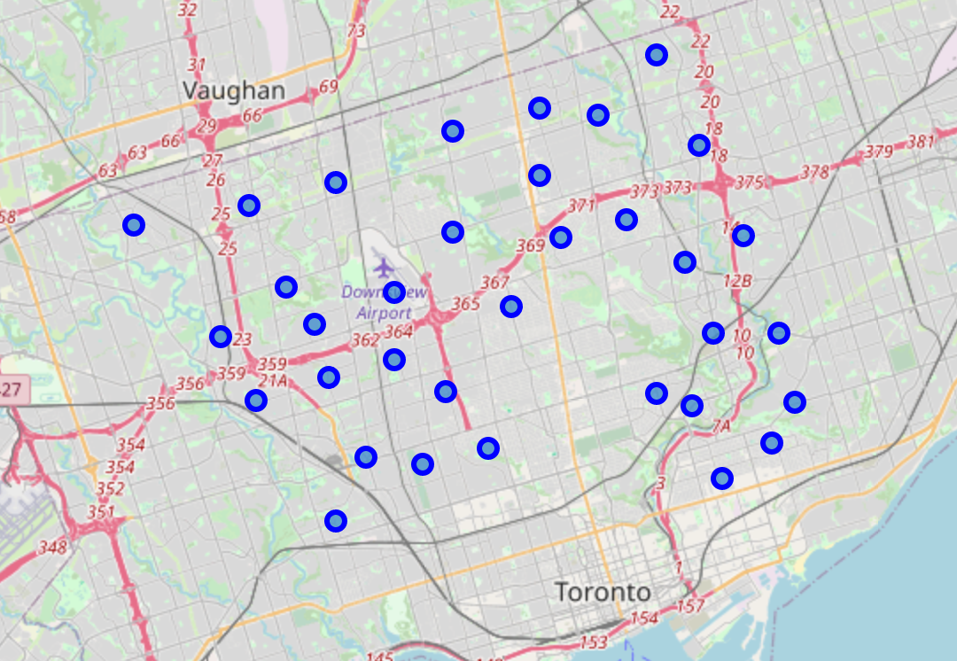
Finding target neighbourhoods

Slide 6
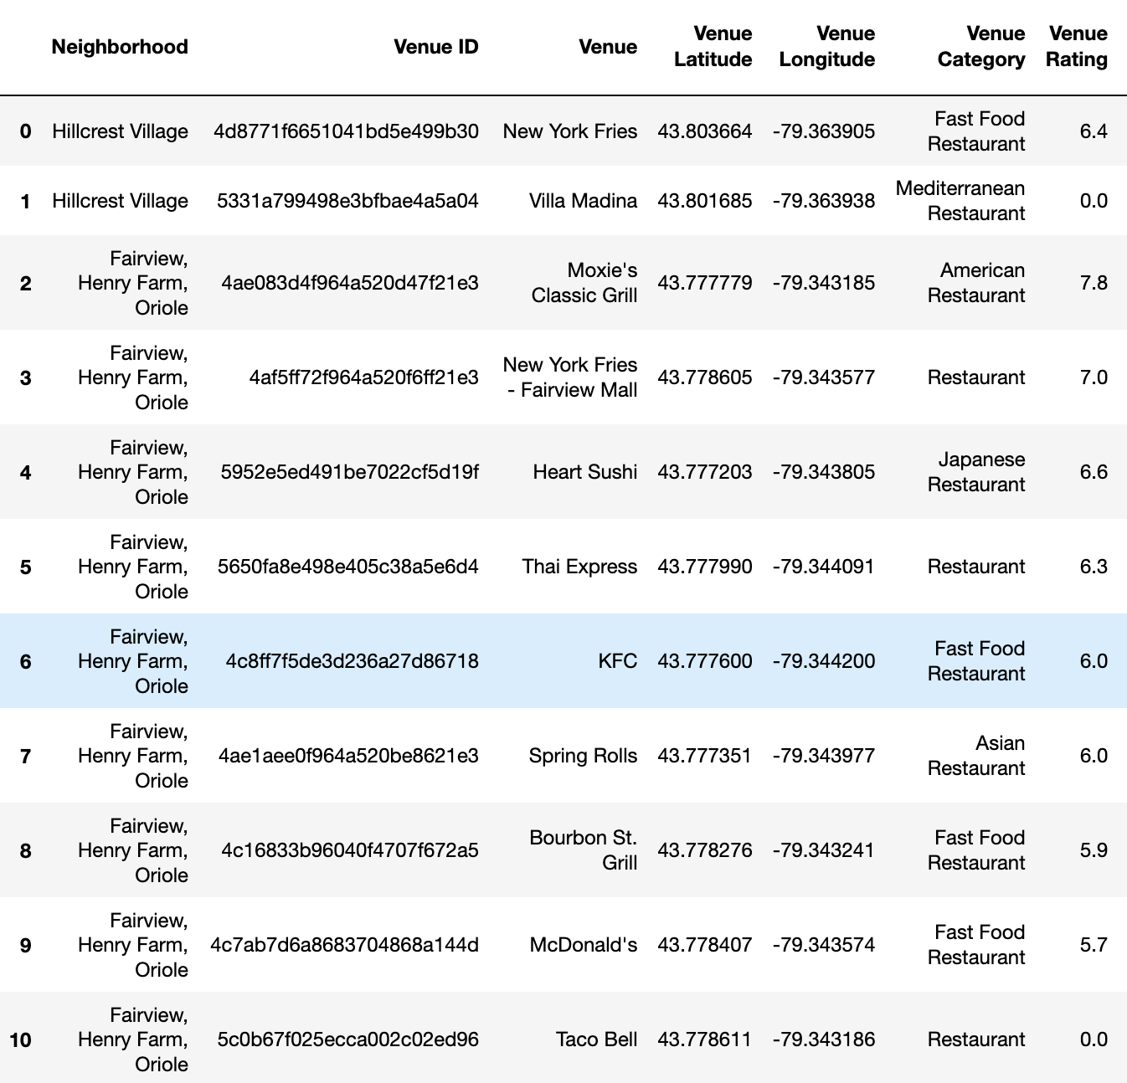
Correlating restaurant type, neighbourhood and rating

Slide 7
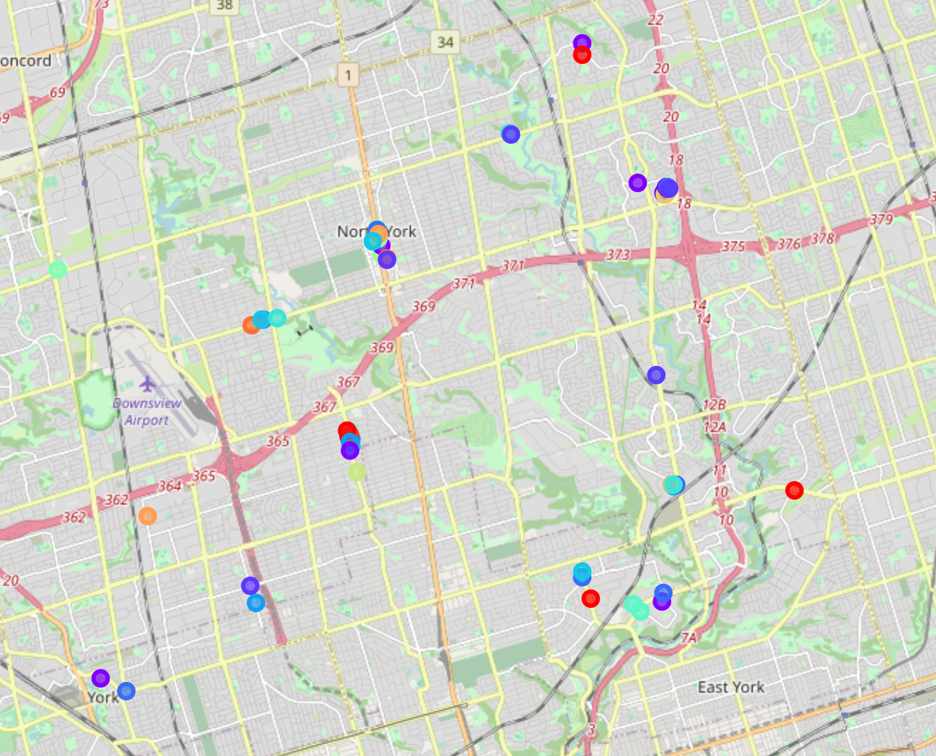
Locating the restaurants around this neighbourhood filtered by rating

Slide 8
Conclusion
By finding all the restaurants with each cuisine type we can correlate with other data.
Crossing this data with the density and scoring we can support new business to find the best place to start a new restaurant.
Additional data support the restaurant to change its cuisine type.

